Slide 1

Prof. Justin Grosz
ALY 6040​
Credit Card Approval Prediction using Data Mining Techniques Final Project
By
Akshay Kirit Kalavadia
Sunil Raj Thota
Jyothi Chandrakanth
Li-Ching Hwang
Nissy Asish Gantepalli

Slide 2
INTRODUCTION
A large number of credit card applications are received by financial institutions. Many of them are turned down for a variety of reasons, such as large debt balances, insufficient income, or too many inquiries on a person's credit report.
Manually assessing these programs is tedious, time-consuming, and error-prone (and time is money!). Fortunately, with the use of machine learning, this work can be automated, and almost every commercial bank does so nowadays.
In this project, we will use machine learning techniques to create an automatic credit card approval predictor, just like real banks use.

Slide 3
BUSINESS PROBLEM
During the previous two decades, the credit card system has been widely used as a tool to propel the world economy toward spectacular growth. Offering credit cards to high-risk consumers, on the other hand, may result in financial crises, which could repeat the events of 2008.
As a result, in this project, we will study a credit card application using data mining techniques in order to assist credit lending organizations in determining whether to accept or reject it.
We'd use the information provided by applicants to predict whether or not they'd default on their credit card payments. One of the most important factors we consider while making this decision is the applicant's credit score history.
A credit score can be used to determine the level of risk. We can create a model based on the applicants' prior data that will tell regulators if a client is a "good" or "risky" customer.

Slide 4




EXPLORATORY DATA ANALYSIS
Data Exploration
In this stage, we have performed EDA to uncover patterns, characteristics, and points of interest. Boxplot has revealed few important outliers which can affect the results.
Data Cleaning
In this project, we need the most accurate data to assess a person’s profile. We want this model to be most accurate to avoid bias judgement. As a part of data cleaning, we have removed all the rows which has missing data to improve performance of the model.
Data Preprocessing
Data Analysis

Slide 5
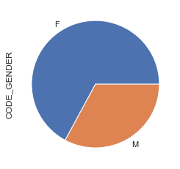
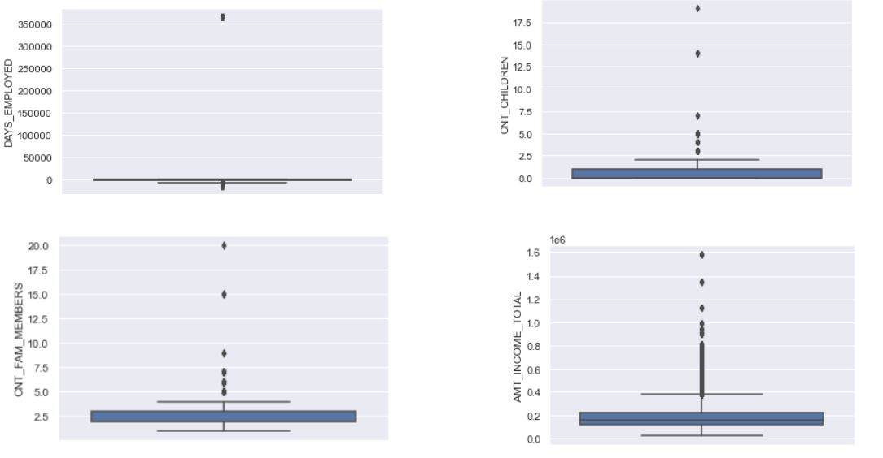
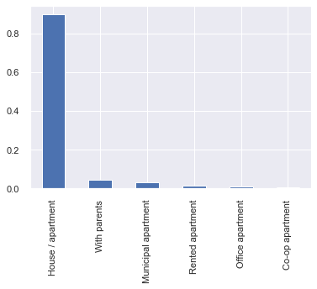
EDA Visualizations

Slide 6
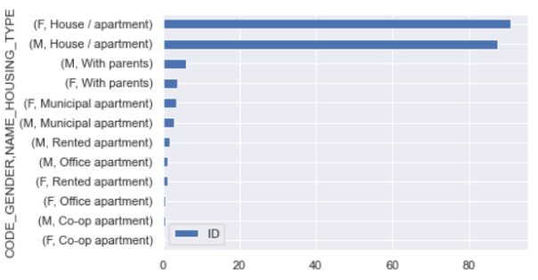
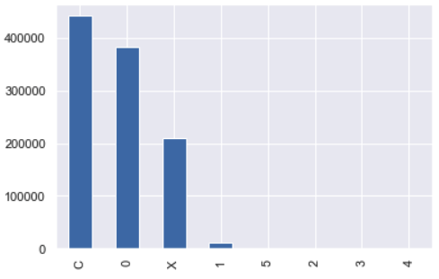
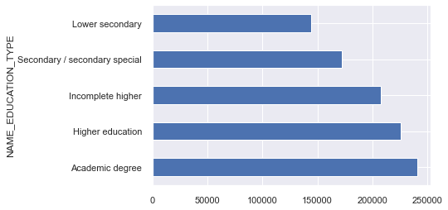

Slide 7
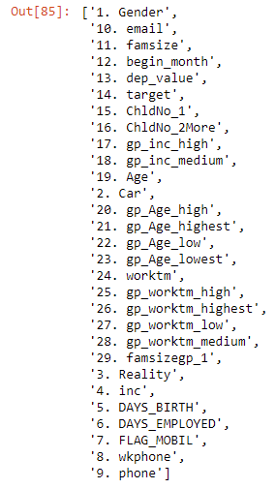
LOGISTIC REGRESSION MODEL
Logistic is an appropriate regression analysis to perform when the dependent variable is dichotomous or binary
It is used to to make classifications into various categories like 1/ 0, Yes/ No, True/ False or Failure/ Success, etc.
While running this model, we constructed confusion matrix of the result from test and train. The accuracy of the model is 65%. Since the accuracy is low, we have decided to build other models.

Slide 8
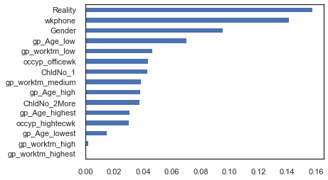
DECISION TREE MODEL
We have used decision tree to build out prediction model.
Using this model, we have built the following confusion matrix. The accuracy of this model is 80%. The important features as per this model are shown below.

Slide 9
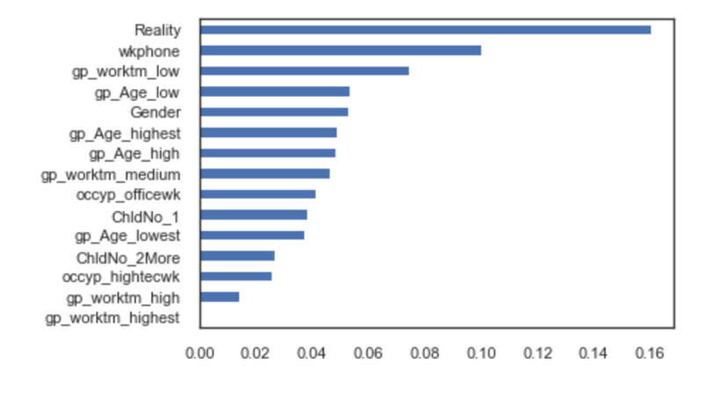
RANDOM FOREST MODEL
Tree-based algorithm that leverages the facility of multiple decision trees for creating decisions
The random forest then combines the output of individual decision trees to get the ultimate output.
The confusion matrix from this model is shown below. The accuracy of this model is 83%.

Slide 10
COMPARISON OF MODELS
MODEL | ACCURACY (%) | SPEED | AIC | MSE | ROC AUC SCORE
LOGISTIC REGRESSION | 65 | 0:00:00.545540 | 29638.91 | 0.346 | 0.714
DECISION TREE | 80 | 0:00:00.212478 | 29640.05 | 0.195 | 0.905
RANDOM FORESTS | 83 | 0:00:06.215095 | 29640.38 | 0.166 | 0.928

Slide 11
CONCLUSION
While evaluating a credit card applicant, accuracy is very important for the judgement. From the model testing done above we can conclude that Random Forest model has the highest accuracy.
We can also conclude that the most important features for consideration by banks are house_type and flag_work_phone column from the dataset.

Slide 12
RECOMMENDATIONS
The Random Forest model that we developed can assist banks in the resolution of bad debts. According to our model, financial institutions should consider an applicant's type of housing when determining his or her capacity to repay the outstanding amount.
If a person is renting an apartment or a home, their finances would be impacted, while their ability to make credit card payments would be reduced.
Registration of a business phone is yet another vital factor to take into consideration. If the applicant's work phone number is recorded with the banks, the banks will be able to immediately reach the card user in the case of a default. If the customer's phone number is not in the system, it will be difficult for them to find them.
This model may also be used by applicants to examine their profile prior to submitting an application for a credit card. If their profile is not strong enough, their application may be rejected.
This will have a negative impact on their total credit score. In order to prevent this, they might leverage this model to improve their profile before submitting their application.

Slide 13
Thank You!

